Slide 1

RATING PREDICTION
Guided By:
Mohd. Kashif
Presented By:
Roshan Kumar Verma
1

Slide 2
INTRODUCTION
We have a client who has a website where people write different reviews for technical products. Now they are adding a new feature to their website i.e. The reviewer will have to add stars(rating) as well with the review.
The rating is out 5 stars and it only has 5 options available 1 star, 2 stars, 3 stars, 4 stars, 5 stars. Now they want to predict ratings for the reviews which were written in the past and they don’t have a rating.
We have to build an application which can predict the rating by seeing the review.
2

Slide 3
EXPERIMENTAL SET UP
Hardware requirements:-
1. Processor — core i5 and above
2. RAM — 8 GB or above
3. SSD— 250 GB or above
Software requirements:-
1. ANACONDA
3

Slide 4
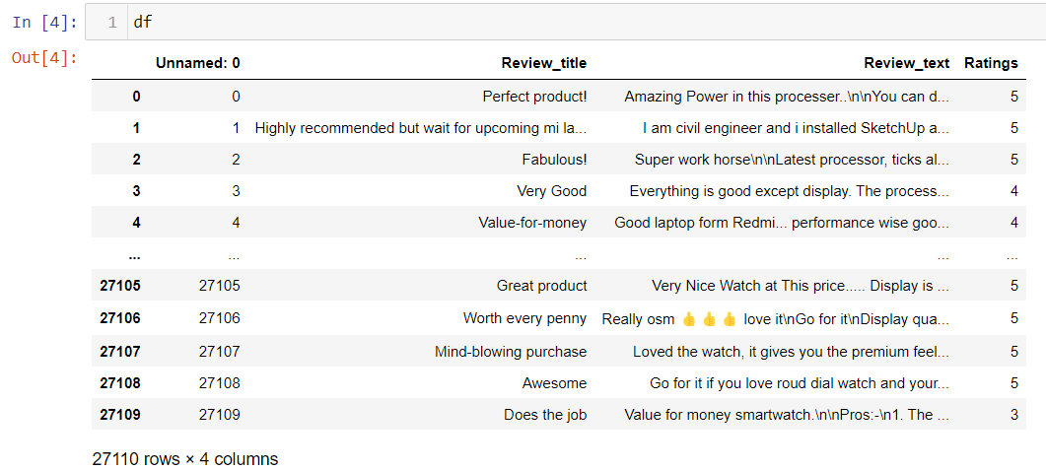
DATA SOURCES AND THEIR FORMAT
We have scraped at least 25000 rows of data , because more the data better the model. In this section we scraped the reviews of different laptops, Phones, Headphones, smart watches, Professional Cameras, Printers, Monitors, Home theater, Router from different e-commerce websites (especially Flipkart).
Basically, we need these columns-
Reviews of the product.
Review summary
Rating of the product.
4

Slide 5
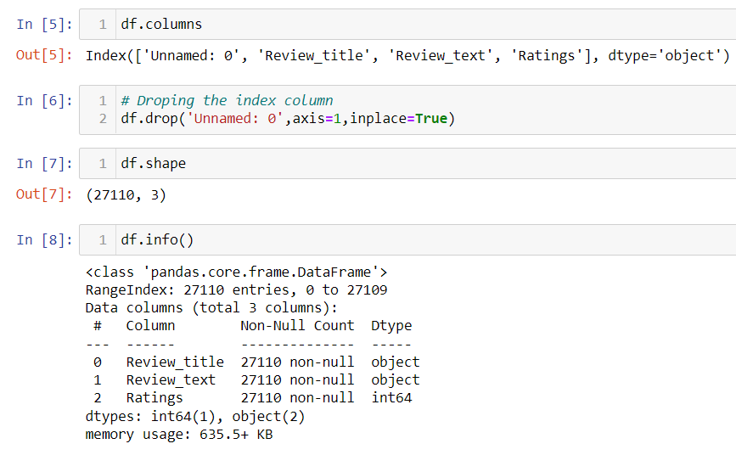
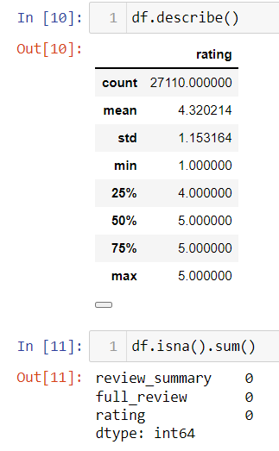
Exploratory Data Analysis
5

Slide 6
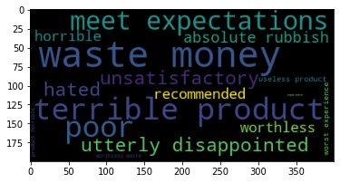
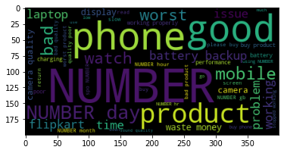
1 STAR RATING
Review Title Review Description
6

Slide 7
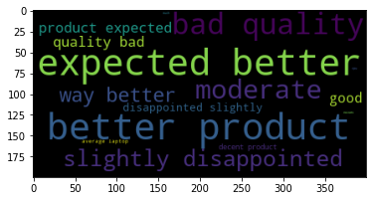
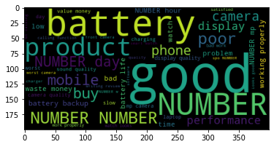
2 STAR RATING
Review Title Review Description

Slide 8
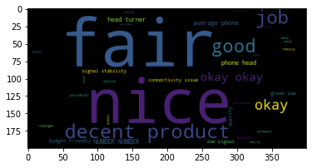
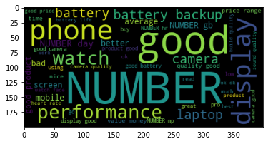
3 STAR RATING
Review Title Review Description
8

Slide 9
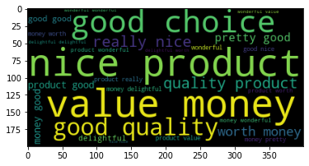
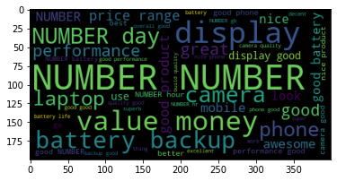
4 STAR RATING
Review Title Review Description
9

Slide 10
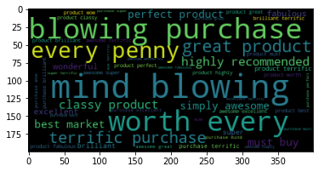
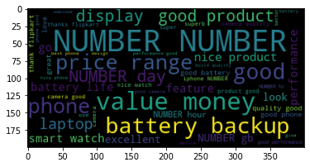
5 STAR RATING
Review Title Review Description
10

Slide 11
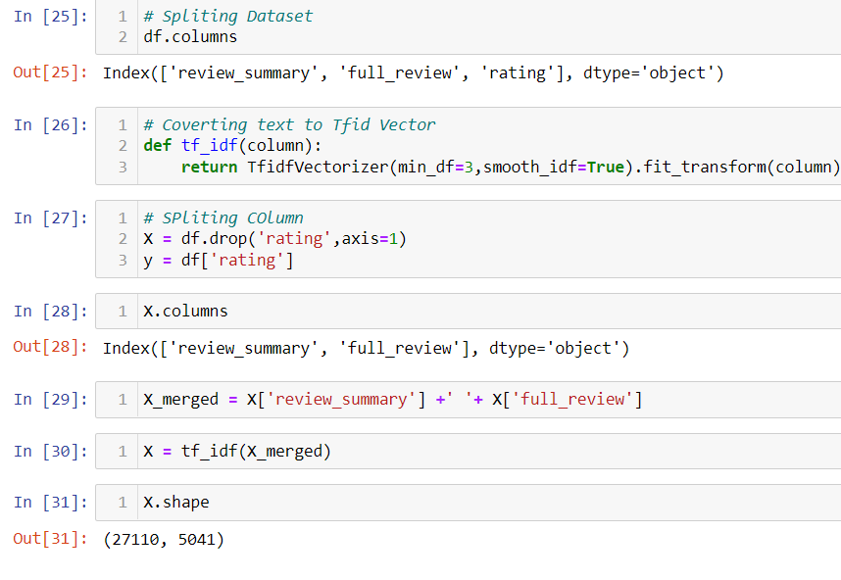
DATA PREPROCESSING
The Complete data is divided in the ration of 80:20 for train and test respectively.
There is no null value present in the data set and almost all the columns type is objective so we don’t need to check for outliers.
Once our data is ready, we’ll do further processing.
I have not dropped any column since the model accuracy is good.
11

Slide 12
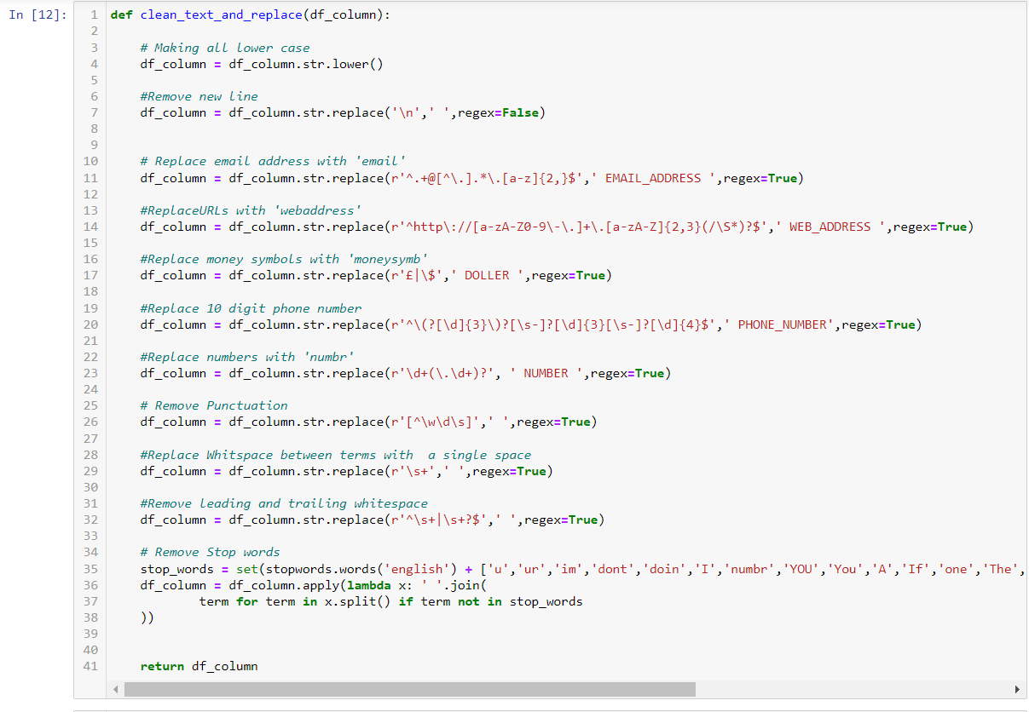
DATA PREPROCESSING
12

Slide 13

EVALUTION PROCESS
Evaluation Matrices:
Accuracy - it determines how often a model predicts default and non default correctly.
Precision-it calculates whenever our models predicts it is default how often it is correct.
Recall- Recall regulate the actual default that the model is actually predict.
Precision Recall Curve - PRC will display the tradeoff between Precision and Recall threshold.
Cross Validations:
K Fold cross validations , K = 5
13

Slide 14
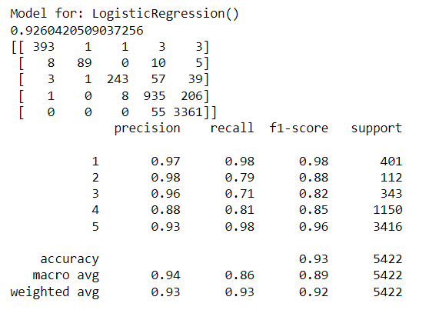
Logistic Regression
14

Slide 15
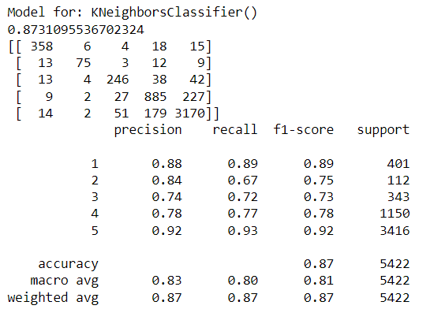
K-neighbors Classifier
15

Slide 16
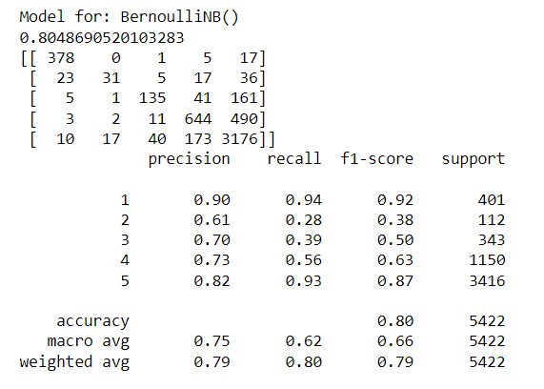
Bernoulli NB
16

Slide 17
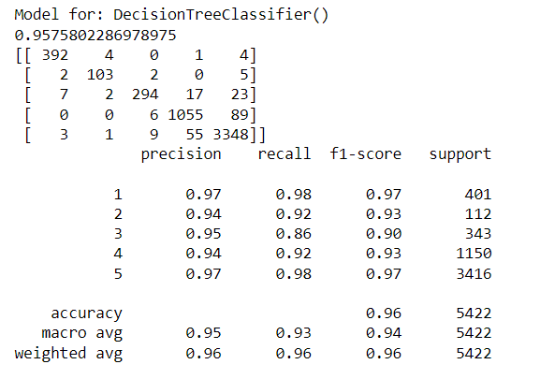
Decision Tree Classifier
17

Slide 18
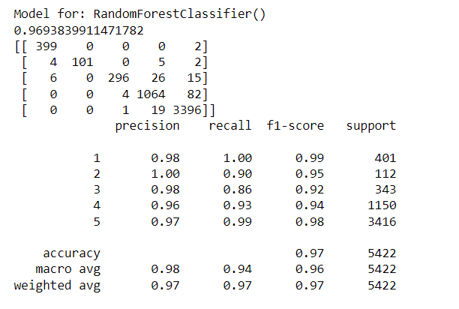
Random Forest Classifier
18

Slide 19
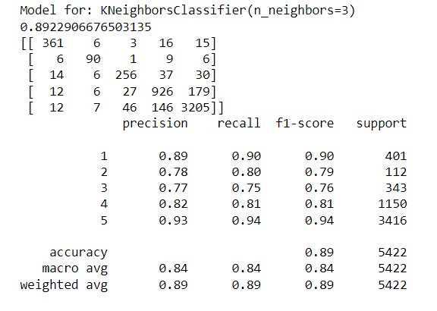
K neighbors Classifier (n_neighbors=3)
19

Slide 20
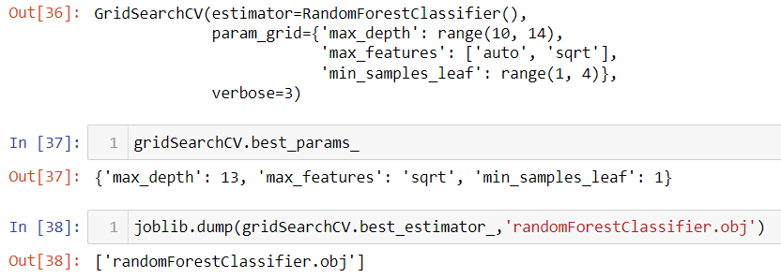
RESULT
From the details on the above solutions it is clearly understandable that we are getting best result with the help of SVC, so we save this model with the help of joblib Library.
20

Slide 21
CONCLUSION
As we know data is increasing in every second in our day today life. So more the data better the model.
If we make this data set for sentiment analysis, we choose ratings 3 or more as our threshold for being helpful reviews or good or positive reviews and below 3 we choose reviews is not helpful or bad reviews or negative reviews.
For example: two people give their reviews on a product as ‘a nice product. But their ratings are ‘4’ and ‘5’ respectively. This is where the model fails to predict whether to choose rating ‘4’ or’5’.
Due to increase in data in our daily basics, this model can be used to predict ratings of reviews.
It might be a good tool for online shopping sites and manufacturer companies who may predict their customers ratings so that they can make their investment according to the demand of customers, which might help them to save time and earn more profits.
21

Slide 22
THANK YOU
Insert the Subtitle of Your Presentation

